Slide 1

A Project Proposal Presentation on Typing Accuracy Check
Research Management Cell
POKHARA ENGINEERING COLLEGE
Phirke, Pokhara-8
(May, 2025)
Submitted by:
Britant Shrestha
Anurag Ale
Manish Shrestha
Ranjana Dhakal

Slide 2
INTRODUCTION
In today's digital age, typing speed and accuracy are essential skills for students, professionals, and casual users alike.
"KeyDash" is a web-based application designed to evaluate typing speed in words per minute (WPM) and accuracy while providing a user-friendly interface.
It offers real-time feedback on typing speed in words per minute (WPM), accuracy, and common errors, helping users to identify and correct weaknesses.
This project utilizes modern web technologies like HTML, Tailwindcss, JavaScript, and React.js to create an interactive and responsive website.
Notes:
Students (taking notes, writing assignments).
Professionals (emails, coding, reports).
Casual users (social media, messaging).
A web-based app (accessible via browsers, no installation needed).
User-Friendly Interface: Easy to navigate, clean design.

Slide 3
PROBLEM STATEMENT
While typing is a fundamental digital skill in today's world, existing typing practice solutions suffer from critical limitations and outdated design.
Many fail to provide real-time feedback on essential performance metrics such as words per minute (WPM), typing accuracy, and error counts.
There is also limited support for diverse typing modes, such as endless typing and paragraph typing, which are crucial for varied practice.
Most applications do not offer integration with platforms like GitHub for version control and collaboration.
Notes:
Many typing tools rely on old UI frameworks, leading to:
Poor mobile/tablet compatibility.

Slide 4
OBJECTIVES
The primary objectives of KeyDash are:
To develop a responsive and interactive typing speed tester using HTML, Tailwindcss, JavaScript, and React.js.
To provide real-time feedback on typing speed and accuracy and implement user authentication for saving and comparing past results.

Slide 5
LITERATURE REVIEW
Rogers and Monsell (1995) discovered that increased typing speeds minimize task completion time in computer-based processes.
Karat et al. (1999) found that better accuracy reduces cognitive strain, allowing users to focus on content rather than mechanics.
More recent research (Chen et al., 2021) emphasizes the relevance of adaptive feedback in increasing skill development, which KeyDash aims to incorporate.

Slide 6
LITERATURE REVIEW
Features | Application
 | 10FastFingers | Typing.com | KeyDash
Platform | Web-based | Web-based | Web-based
Progress Tracking | No | Basic | Advanced
What We Measure | WPM only | WPM & Accuracy | WPM, Accuracy and Error Detection
Data Source | Random text | Pre-set lessons | Custom Texts

Slide 7
METHODOLOGY
Agile Development: Iterative sprints with GitHub for task tracking.
Tech Stack:
Frontend: HTML, React.js (hooks, components), Tailwindcss for styling.
Version Control: GitHub (branches, pull requests).
Design: Figma
Saving system: Firebase
Notes:
Agile development :flexible and iterative methodology for software development.
Why
Faster delivery of usable feature., better respone to changes., improves teamwork and provides transparency

Slide 8
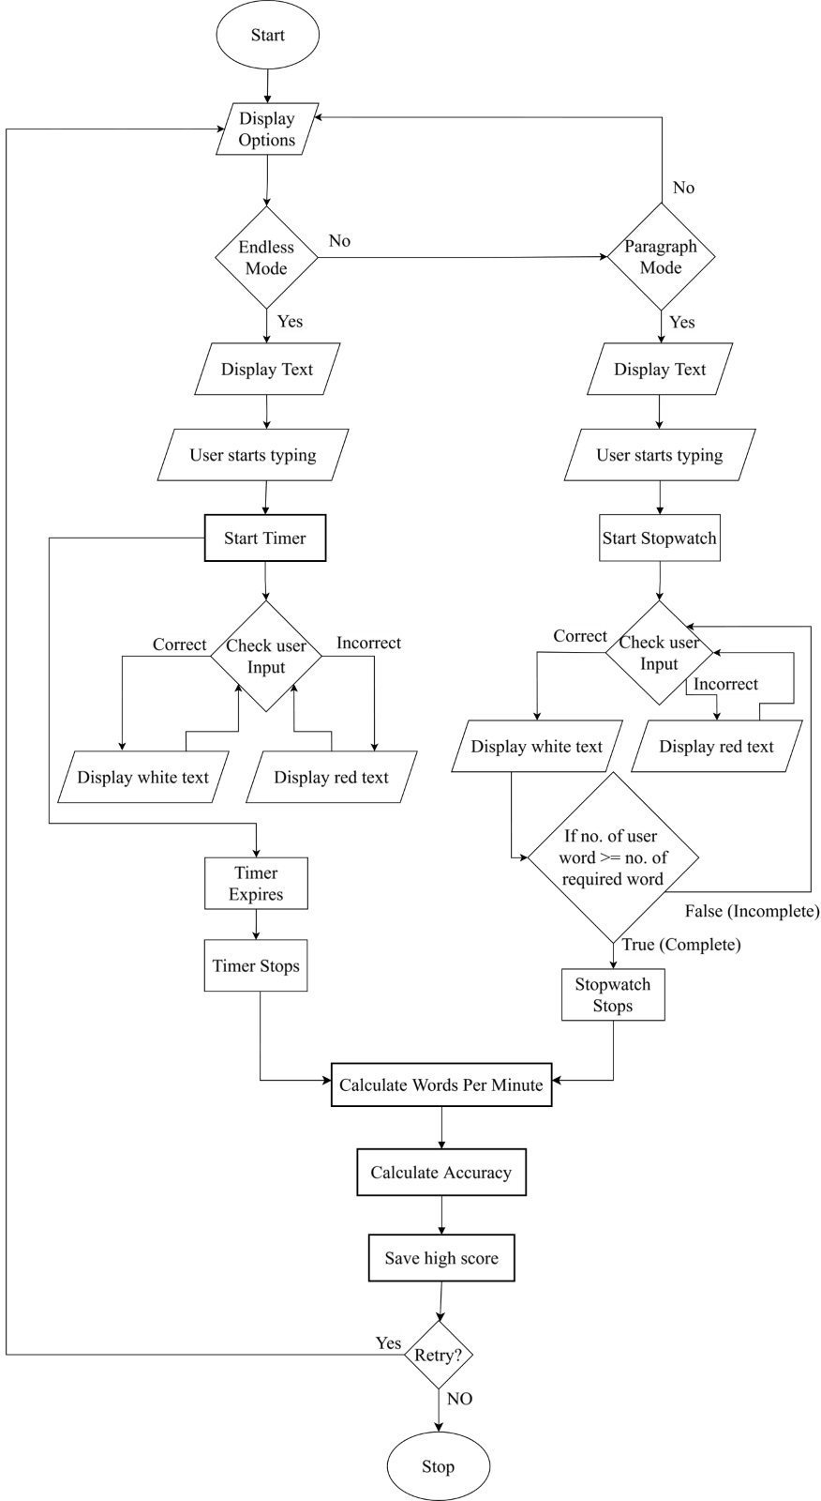
FLOWCHART:

Slide 9
TOOLS
Tools / Technology | Purpose
HTML | Structure and semantic markup of web pages
Tailwindcss | Utility-first CSS framework for styling
React.js | JavaScript library for building user interfaces
VS Code | Code editor with extensions for development
Git | Version control system
Github | Remote repository hosting
Figma | UI/UX design and prototyping
Firebase | Score saving system.
Notes:
Frontend: provides efficient, modular and responsive ui
Deeve:smooth coding , version control and teamwork
Design figma ensures user friendly interface
Backend: firebase: simplifies data storage scores without full server setup

Slide 10
PROJECT SCHEDULE
Task | Week 1 | Week 2 | Week 3 | Week 4 | Week 5 | Week 6 | Week 7
Research & Planning
UI Design
Core Functionality
Testing & Debugging
Final Documentation
Notes:
Objectives, requirements
Figma
React firebase
Distribute class
documentation

Slide 11
EXPECTED RESULTS
Typing Performance Metrics: Accurately measure users’ typing speed (WPM) and error rates with real-time feedback.
To provide different typing modes like endless typing and paragraph typing.
To enable progress tracking with saved history and personalized insights.

Slide 12
REFERENCES
10FastFingers: Website: https://10fastfingers.com
Typeshala: Website: http://typeshala.shresthasushil.com.np/
Rogers, R. D., & Monsell, S. (1995). Costs of a predictable switch between simple cognitive tasks. Journal of Experimental Psychology: General, 124(2), 207–231.
Chen, Y., Chen, Y., & Huang, Y. (2021). Adaptive feedback systems and their impact on learning performance: A meta-analysis. Computers & Education, 174, 104309.
Zhang, L., & Sun, T. (2023). Real-time feedback systems in typing tutors: A WebSocket-based approach. Journal of Educational Technology & Society, *26*(1), 89-102.

Slide 13
THANK YOU

